Slide 1

DEMS Integration – Proposed Design
For Review and Discussion Nov 22, 2021
Prepared by David Agahchen, Andrew Cripps, Robert St-Aubin
Integrations Product Owner: Jennifer Dowd
Notes:
jennifer

Slide 2

Agenda
Solution Assumptions
Approach and Patterns
Integration Service Layer – High Level Concept
Deliverables Required (to get to an estimate)
Questions
Notes:
Jennifer

Slide 3
Solution Assumptions
Integration layer will be built with API First integration style (with domain APIs)
DEMS (EDT) will retain a copy of some of the static digital evidence from JUSTIN for reference and auditability while looking up some other JUSTIN information. This determination is still pending.
DEMS may be used to record additional (tangential) evidence data as part of the evidence management process
JUSTIN’s existing integrations with other systems (including PRIMECorp) will continue to function as-is and is out of scope for this project
In the context of the DEMS Integration project,
JUSTIN is the court case management system (with demographic info, narratives, etc.)
DEMS will be the evidence management system for treating (e.g. redacting) and disclosing relevant evidence to the right parties
Current evidence management solution involves manipulating files in a shared case folder
CORNET is the corrections system providing details for defendants who are in custody and will need to be contacted to determine the workflow around e-disclosures, etc.
All BCPS DEMS users will exist as users in JUSTIN for court case access management and the access model within DEMS will be driven by the JUSTIN access model
Notes:
Robert

Slide 4
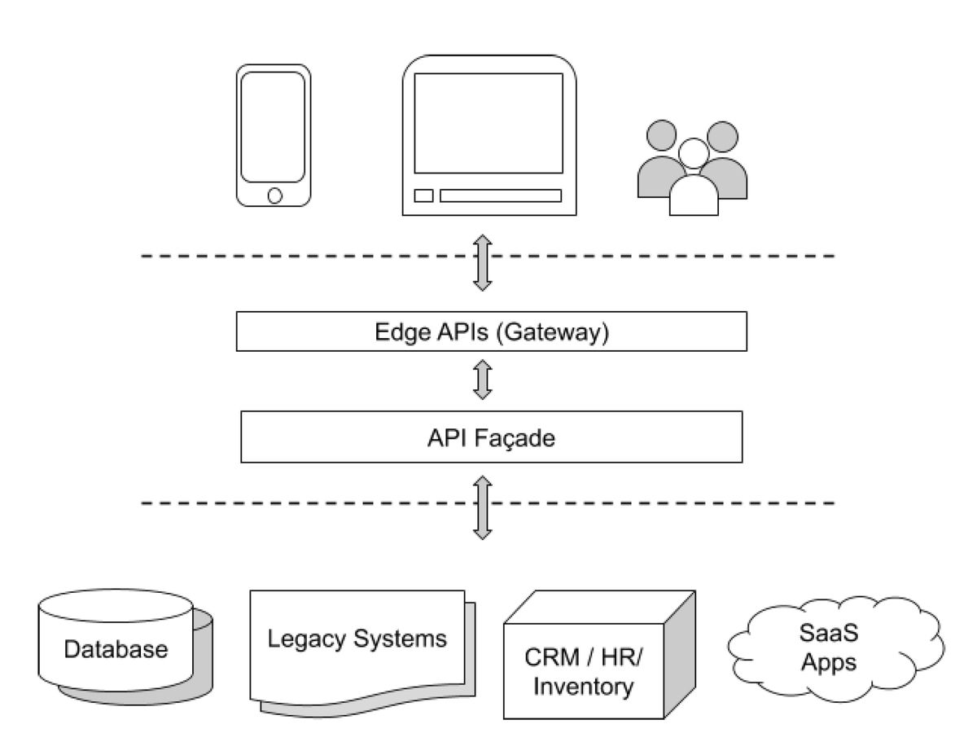
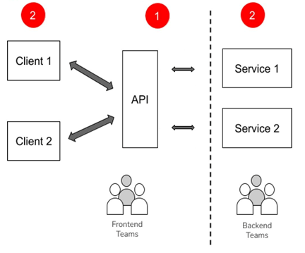
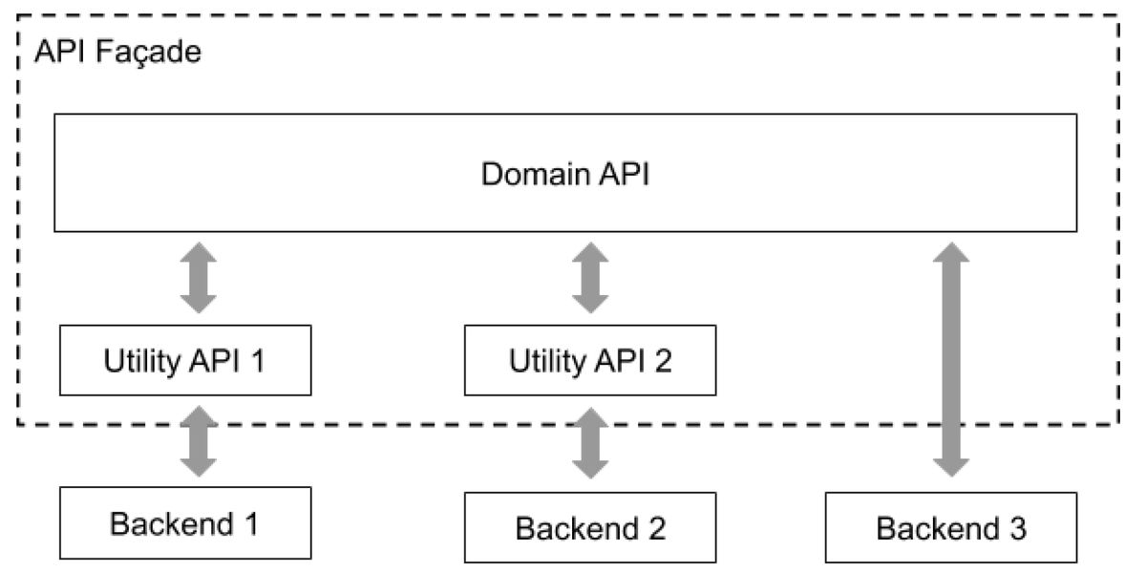
API-First Integration Defined
Design the domain APIs before designing the edge and utility APIs.
Notes:
David
Source: https://www.infoq.com/articles/api-first-integration/

Slide 5
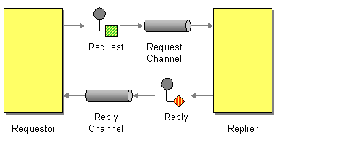
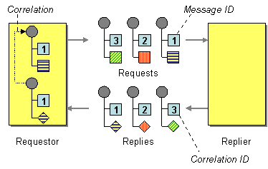
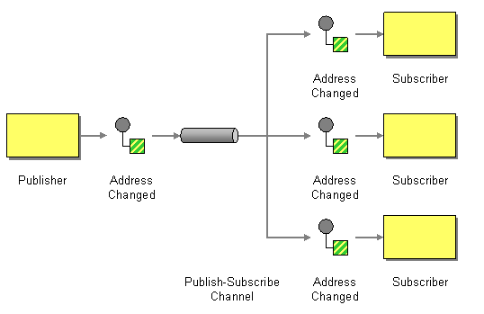
Integration pattern #1
Integration pattern #3
Correlating Identifier Messaging Pattern – required when implementing notification-with-receipt interactions
Request-Reply Messaging Pattern – required when implementing synchronous (on-demand) interactions
Integration pattern #2
Publish-Subscribe Channel Messaging Pattern – required when implementing notification-based interactions
Use Case
Lookup accused history list
Use Case
DEMS to CORNET notification with acknowledgement
Use Case
JUSTIN to DEMS integration – case creation and case asset
Notes:
David
These are integration patterns we are using as part of the solution.
Integration Pattern #1 Source: https://www.enterpriseintegrationpatterns.com/patterns/messaging/RequestReply.html
Integration Pattern #2 Source: https://www.enterpriseintegrationpatterns.com/patterns/messaging/PublishSubscribeChannel.html
Integration Pattern #3 Source: https://www.enterpriseintegrationpatterns.com/patterns/messaging/CorrelationIdentifier.html

Slide 6

Integration Service Layer
High Level Concept

Slide 7
Integration Service Layer for the Evidence and Disclosure Management Domain
JUSTIN
CORNET
JUSTIN Utility Adapters
CORNET Utility Adapters
Examples
Create case
Update case asset
Example
Accused history list
Example
User / court case access
permission
Examples
Eligibility status
Bulk eligibility status
Example
Readiness notification
Notification delivered
Court Case Notification Service (Queues)
Court Case Lookup Service (APIs)
User Access Lookup Service (APIs)
e-Disclosure Eligibility Lookup Service (APIs)
e-Disclosure Readiness Notification Service (Queues)
Integration
Pattern #2
Integration
Pattern #1
Integration
Pattern #1
Integration
Pattern #1
Integration
Pattern #3
DEMS Edge Adapters
DEMS Utility Adapters
DEMS
Notes:
David

Slide 8
JUSTIN
CORNET
JUSTIN Utility Adapters
CORNET Utility Adapters
Business Description
This service notifies consumers, like DEMS, that a business event has occurred in a source business system – in this case JUSTIN.
Example business events are “create case”, “update case”, “narrative complete” and so on.
Design Considerations
There are legislated time constraints on delivery of events
Never lose a message even if a component fails
Guarantee delivery of messages
All messages are audited
All messages can be monitored
Implementation Options (DRAFT)
1. Primary implementation option is a secure queue.
2. The event notifier, JUSTIN, puts the event on the queue. The event receiver, DEMS, is notified there is something on the queue.
Implementation question:
Put entire case data on the queue as a “notification”
Give the consumer a token to go and retrieve all or some of a case’s details
Examples
Create case
Update case asset
Court Case Notification Service (Queues)
Integration
Pattern #2
DEMS Edge Adapters
DEMS Utility Adapters
DEMS
Notes:
Andrew

Slide 9
JUSTIN
CORNET
JUSTIN Utility Adapters
CORNET Utility Adapters
Business Description
This service allows consumers, like DEMS, to make requests for information.
Consumers do this in response to notifications they have received (like a case being created) and for other business reasons, such as looking up the accused history list.
Design Considerations
Data minimisation principle- don’t publish more information than is needed
There are potentially many business needs for case information, not just DEMS
If the data recorded about cases ever expands, then new “get” requests can be added as discrete requests
Discrete requests for pieces of case data allow for higher control over release of case information.
Implementation Options (DRAFT)
Main implementation option would be as a consumer REST service using adaptors for JUSTIN and DEMS (and in future other consumers). Pattern is request/response.
Implementation questions:
Create a general “Get case” service as well as many “get case detail” services?
Court Case Lookup Service (APIs)
Integration
Pattern #1
DEMS Edge Adapters
DEMS Utility Adapters
DEMS
Notes:
Andrew

Slide 10
JUSTIN
CORNET
JUSTIN Utility Adapters
CORNET Utility Adapters
Example
User / court case access
permission
Business Description
The purpose of this service to check whether a given BCPS user has access to a particular case. The consumer, DEMS, would make a request and provide the user ID and the Case ID/number.
Design Considerations
Assume DEMS and JUSTIN have the same BCPS users (DEMS has additional user groups)
Can JUSTIN determine for a BCPS user overall access to a case, or is authorisation at a finer grain (e.g. witness statements only, or narrative and witness statements ,etc.)
Could be a list of items user has access to or just “allow/deny” at the case level?
Implementation Options (DRAFT)
Main implementation option would be as a consumer REST service using adaptors for JUSTIN and DEMS (and in future other consumers). Pattern is request/response.
Implementation questions:
None identified at present
User Access Lookup Service (APIs)
Integration
Pattern #1
DEMS Edge Adapters
DEMS Utility Adapters
DEMS
Notes:
Andrew

Slide 11
JUSTIN
CORNET
JUSTIN Utility Adapters
CORNET Utility Adapters
Business Description
This service allows DEMS to confirm with Corrections what the status is for a given accused party. The response is either in or out of custody, and whether the party is able to receive eDisclosures.
Design Considerations
DEMS wants to determine whether an accused party is eligible to receive eDisclosure. This implies an understanding from the service provider of the accused status, facility capabilities, etc.
Consumers, like DEMS, would like to make requests for more than one accused party at a time.
Implementation Options (DRAFT)
Main implementation option would be as a consumer REST service using adaptors for CORNET and DEMS (and in future other consumers). Pattern is request/response.
Implementation questions:
Support for requests for multiple accused parties could be achieved synchronously and/or through an asynchronous request satisfied by the service provider overnight as a batch job
Examples
Eligibility status
Bulk eligibility status
e-Disclosure Eligibility Lookup Service (APIs)
Integration
Pattern #1
DEMS Edge Adapters
DEMS Utility Adapters
DEMS
Notes:
Andrew

Slide 12
JUSTIN
CORNET
JUSTIN Utility Adapters
CORNET Utility Adapters
Examples
Readiness notification
Notification delivered
Working on details
e-Disclosure Readiness Notification Service (Queues)
Integration
Pattern #3
DEMS Edge Adapters
DEMS Utility Adapters
DEMS
Notes:
Andrew

Slide 13

Deliverables Required

Slide 14
Deliverables Required This slide outlines the work required to be able to get an estimate, from the vendor team.
Identify discovery work required
All business and non-functional requirements (e.g. auditability of business events) captured
Confirm the solution architecture business flows and use cases
Fit / Gap of Red Hat Integration (POC)
Potential system limitations or constraints (JUSTIN and CORNET) based on proposed integration solution
4-week Red Hat Integration POC – Implement Court Case Approved business event with error monitoring
Mock services representing JUSTIN and DEMS
Agile integration architecture
Monitoring dashboard solution
Audit trails
Splunk integration
This work will enable NTT Data to provide an estimate.
Notes:
Jennifer

Slide 15

Questions

